Slide 1
CTU Presents
Youth In Contesting Update!
Marty, NN1C

Slide 2
Introduction
Quick intro to me
A few slides to run though…
Q&A

Slide 3
A little bit about me…
From Boston, MA
”In contesting” since 2015. Always learning.
Formerly KC1CWF
Often found at KC1XX, W1KM and K1VR
I’m part of the ZF1A contest crew, I’m ZF2LZ
Proud CW op.
Technologist, hardware and software designer for contesting.

Slide 4
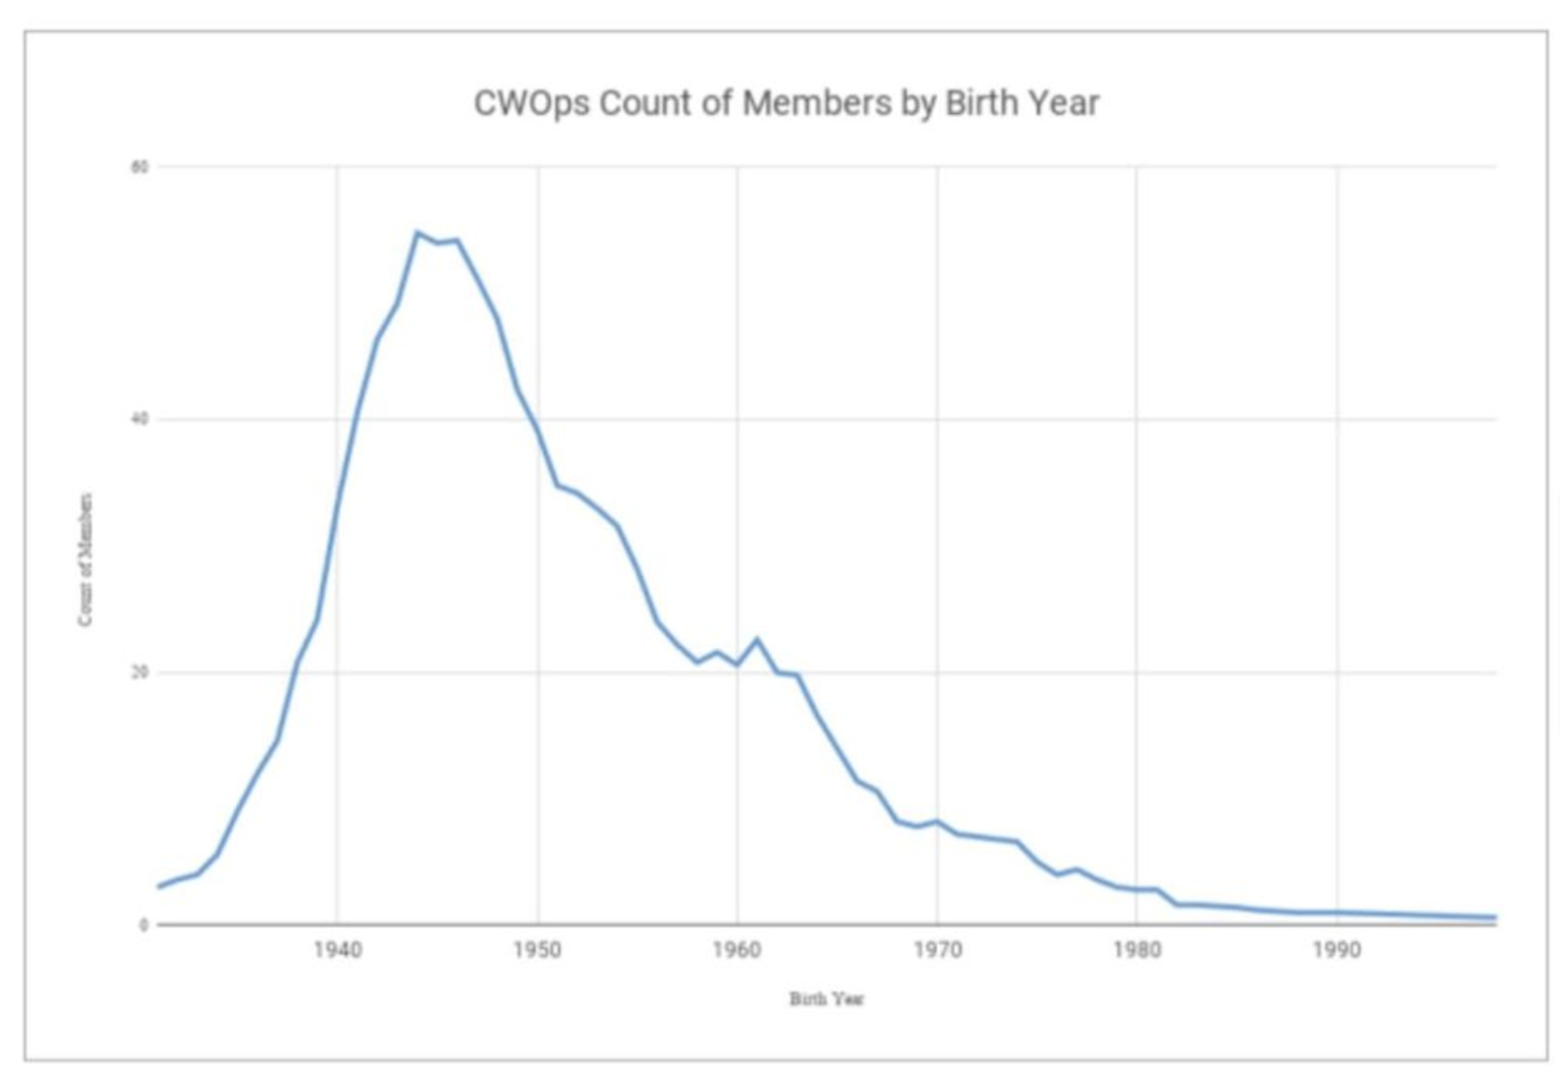
Why Youth?

Slide 5
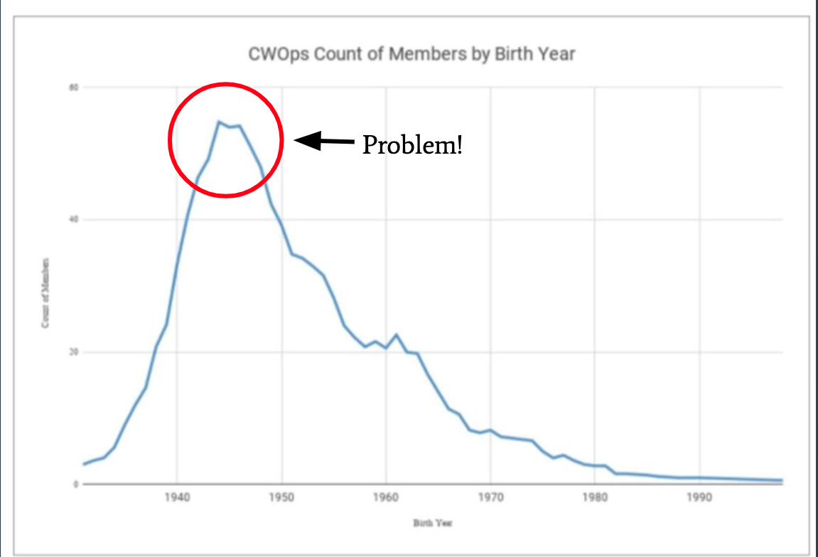
Why Youth?

Slide 6
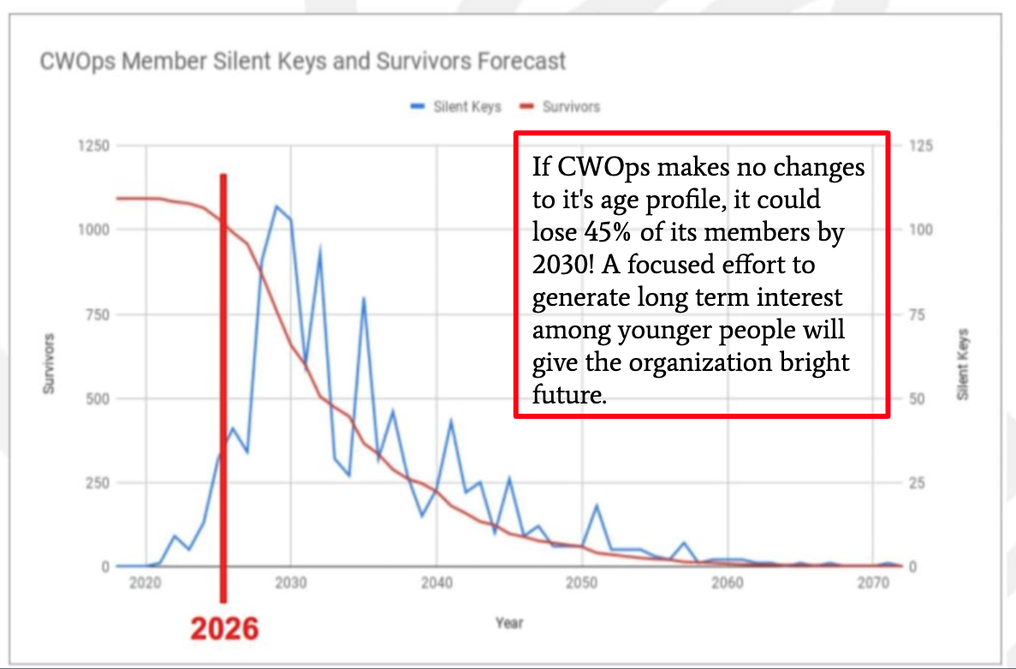
Why Youth?

Slide 7
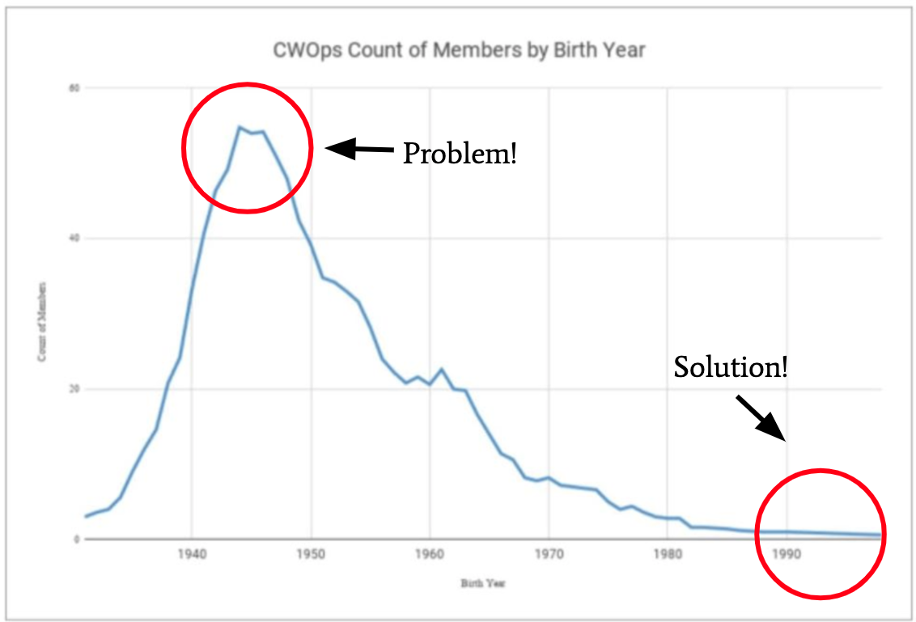
Why Youth?

Slide 8
Youth In Contesting Landscape
YOTA YCP (Europe)
YOTA R2
Dave Kalter YDXA
Team Exuberance
YARC YCP (USA)

Slide 9
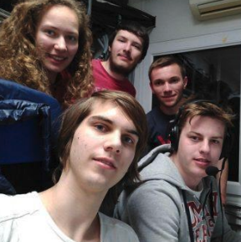
Youngsters on the Air (YOTA)
IARU Region 1 Program
Funded via IARU and donations
Youths travel to European contest stations for all-youth multiops

Slide 10
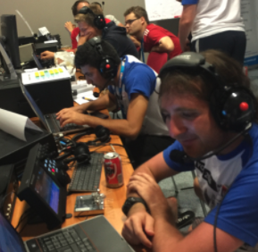
Youth On The Air (Region 2)
YOTA Camp scheduled for summer 2020
Pushed to summer 2021.
Strong contesting workshop led by myself, and KG5HVO.
K3LR banquet speaker!

Slide 11
Dave Kalter Memorial YDXA
Takes youth to DX locations
Organized by Jim, AB8YK, Ron, N8VAR, and Don, N6JRL.
Recent trips include TI5, PJ2, and PJ6.
In memory of Dave Kalter, KB8OCP.

Slide 12
Team Exuberance
North American based group of young contesters
Youth led, organized, and operated serious multi-op contest entries
Founded by Violetta KN2P, Led by myself, and Bryant, KG5HVO.
Non-profit dedicated to making these opportunities affordable.
Teamexuberance.og

Slide 13
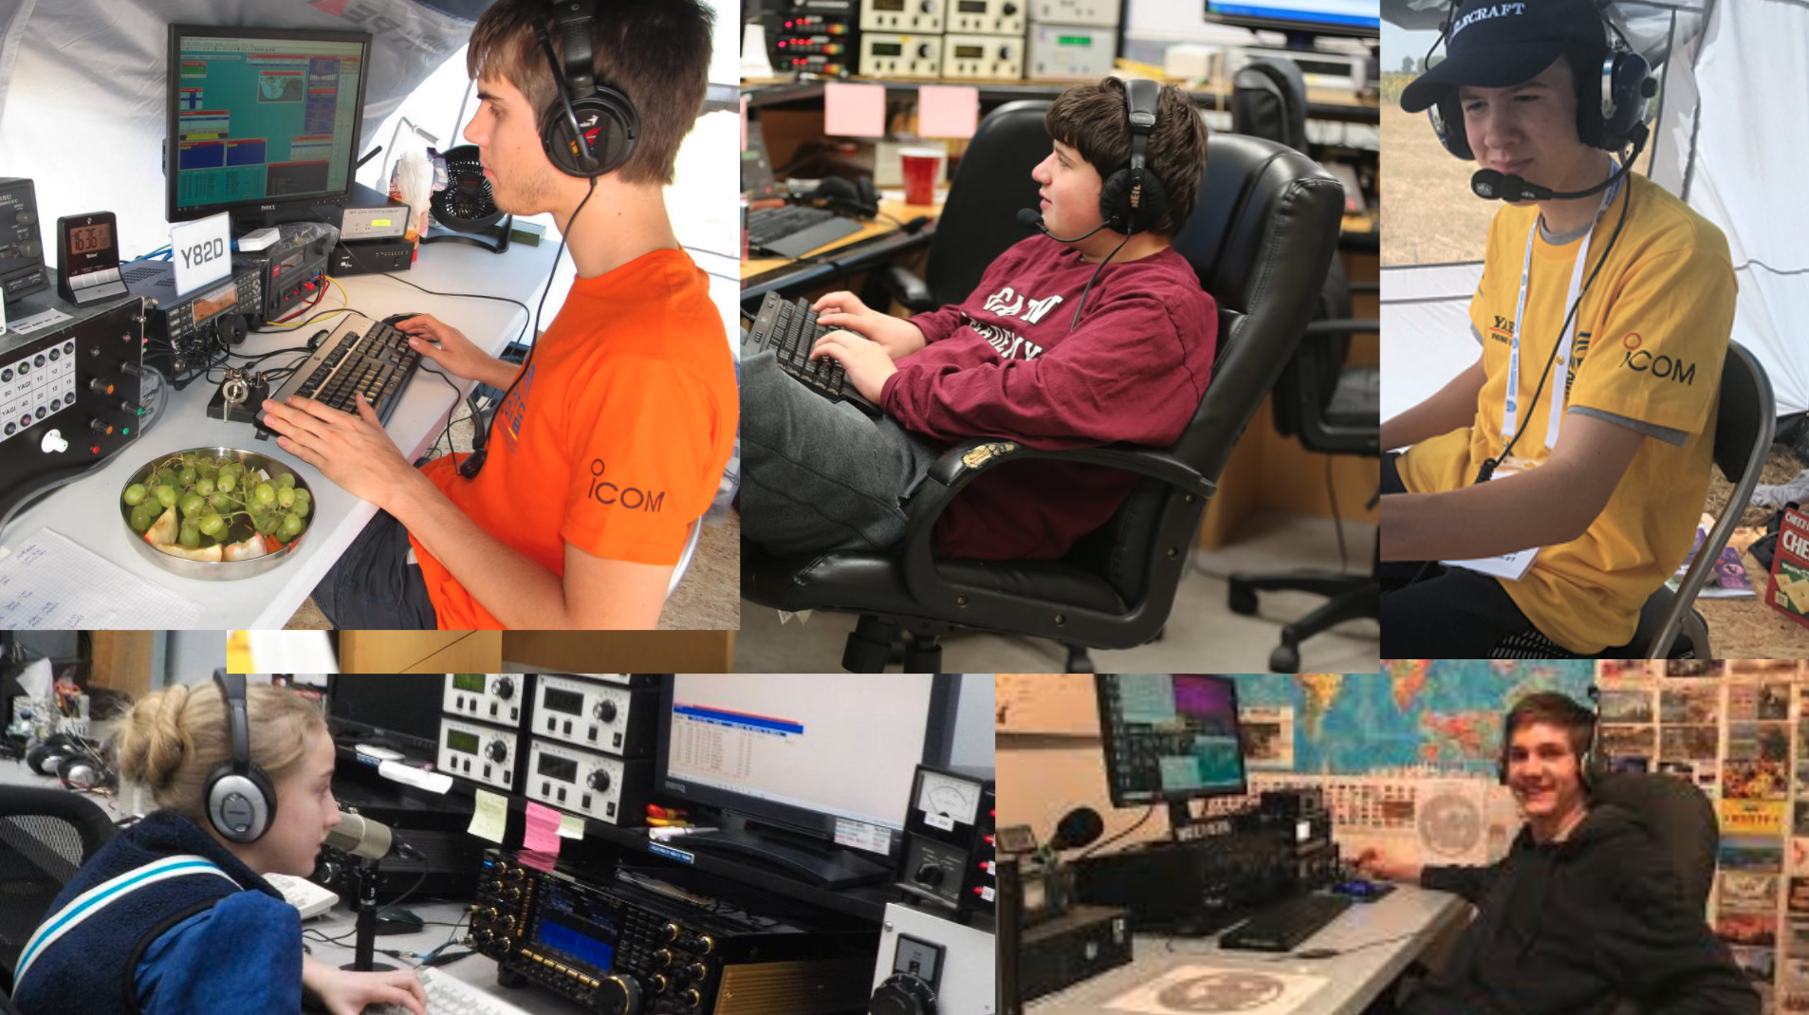
Team Exuberance Operators

Slide 14
Team Exuberance Operations
Previous Operations
Planned Operations
CQ WPX SSB 2019
M/2 @ K3LR → #1 North America
7 Ops from 3 different countries.
Led by myself, and Violetta, KN2P
CQ WPX CW 2021
Postponed due to COVID-19.
Another elite team of CW operators to operate M/2 at K3LR.
Led by ex-WRTC op, Bryant, KG5HVO.
Fundraising paused, will resume soon.

Slide 15
Questions?
Youth In Contesting Update!
Marty, NN1C

